Slide 1
Machine Learning for Multi-hole Probe Calibration
Dr. Arman Mirashemi, Dr. Paht Juangphanich

Slide 2
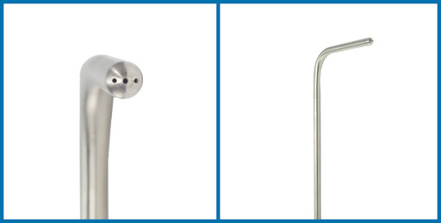
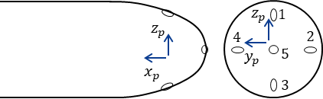
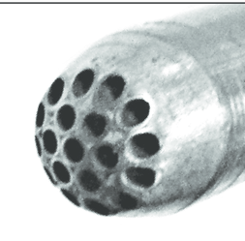
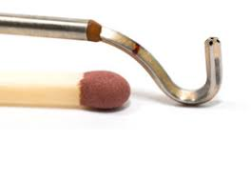
Multi-Hole Probe Background
Notes:
Examples of multi-hole probes. These are very useful for measuring and determining flow angle by comparing the pressure hole readings

Slide 3
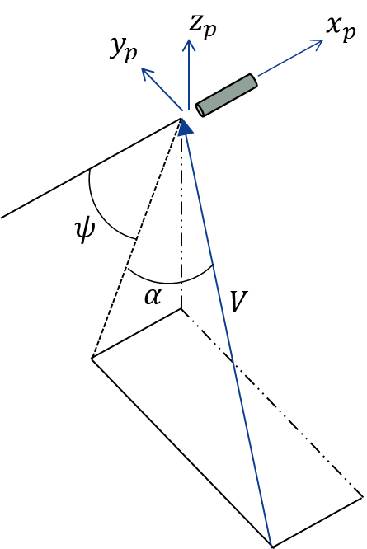
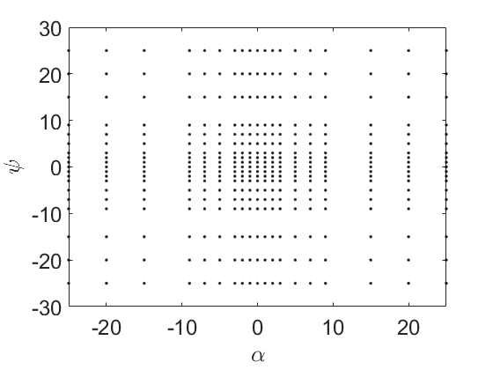
Calibration
Calibration Map
Each point is a reading of P1,P2,P3,P4,P5,P0,Ps
Goal: Predict ψ, α, P0/Ps using
Notes:
Calibration procedure involves pivoting about the tip of the probe in the pitch and yaw directions at different mach numbers e.g. ratio of Total to Static Pressure

Slide 4
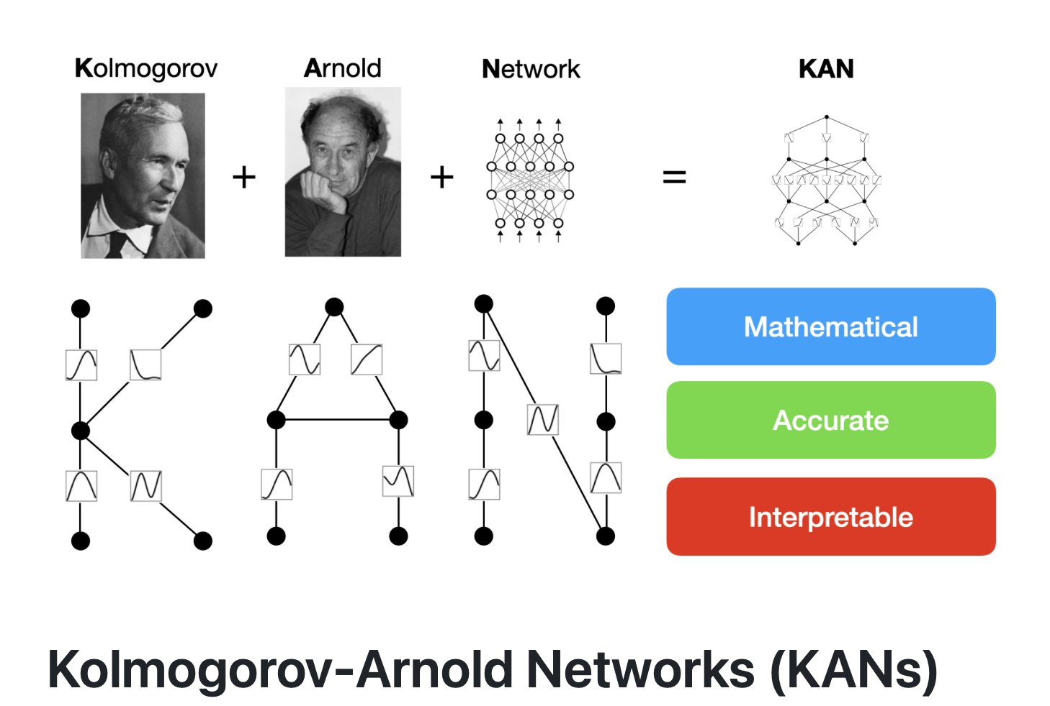
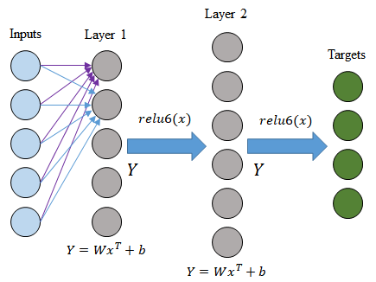
Machine Learning Methods
Simple ANN or MLP Network (<2010)
KAN Network (2024)

Slide 5
Code and Tutorials
https://gitlab.grc.nasa.gov/ideas/probe-calibration

